Slide 1


Eric Favour
16/07/24

Slide 2

Outline
Executive Summary
Introduction
Methodology
Results
Conclusion
Appendix

Slide 3
Executive Summary
Summary of Methodologies
Data Collection:
SpaceX API: Gathered detailed launch data.
Web Scraping: Extracted historical data from Wikipedia.
Data Wrangling:
Cleaned and transformed data.
Addressed missing values and ensured quality.
Exploratory Data Analysis (EDA):
Visualized trends and patterns.
Plotted charts to explore data relationships.
Interactive Visualizations:
Folium Maps: Visualized launch sites and outcomes.
Plotly Dash: Developed interactive dashboards.
Predictive Modeling:
Trained classification models (Logistic Regression, SVM, Decision Tree, KNN).
Evaluated using accuracy, precision, recall, F1 score, ROC AUC.
Model Validation and Selection:
Applied cross-validation.
Selected KNN as the best-performing model.
Summary of Results
EDA Findings:
Launch Success by Site: CCAFS SLC-40 highest at 41.2%.
Payload & Success: Higher success for 4000-6000 kg payloads.
Orbit & Success: SSO and VLEO highest success rates.
Yearly Trend: Improved success post-2015, peak in 2018-2019.
Interactive Visualizations:
Folium Maps: Showed site proximities and outcomes.
Plotly Dash: Enabled dynamic data exploration.
Predictive Modeling:
KNN Model:
Accuracy: 83%
Precision: 0.80
Recall: 1.00
F1 Score: 0.89
ROC AUC: 0.90
Confusion Matrix (KNN): 12 TP, 3 FP, 3 TN, 0 FN.
Key Takeaways:
Best Model: KNN with highest accuracy and ROC AUC.

Slide 4
Introduction
Overview
Space Y, a new rocket company aiming to compete with SpaceX, founded by billionaire industrialist Allon Musk, seeks to leverage data science to gain a competitive edge. The objective of this project therefore is to gather and analyze SpaceX's launch data to make informed strategic decisions and predict key operational outcomes to help Space Y.
Objectives
First Stage Reusability Prediction: Can we develop a reliable machine learning model to predict whether the first stage of a SpaceX rocket will be successfully reused, using public information and historical data?
Data-Driven Decision Making: How can interactive dashboards be utilized to visualize and analyze SpaceX's launch data, providing valuable insights for strategic planning and operational improvements at Space Y?
Optimization of Launch Operations: What key factors influence the success and cost-effectiveness of rocket launches, and how can Space Y optimize these factors to enhance its competitiveness in the market?

Slide 5

Section 1

Slide 6
Methodology
Executive Summary
Data Collection Methodology:
Collected data from SpaceX API and Wikipedia.
Used BeautifulSoup for web scraping launch data.
Saved collected data into CSV files.
Data Wrangling:
Cleaned data by handling missing values.
Created training labels for booster landing outcomes.
Identified and processed numerical and categorical features.
Exploratory Data Analysis (EDA):
Visualized data relationships using scatter plots and histograms.
Executed SQL queries for detailed analysis.
Key insights on launch sites, payload mass, and mission outcomes.
Interactive Visual Analytics:
Developed Folium maps to visualize launch sites and outcomes.
Built a Plotly Dash interactive dashboard for deeper insights.
Visualized success rates by launch site and payload mass.
Predictive Analysis:
Built and evaluated classification models: Logistic Regression, SVM, Decision Tree, KNN.
Optimized models using GridSearchCV for best accuracy.
KNN model achieved ~84% accuracy, best predictor for launch outcomes

Slide 7
Data Collection
SpaceX API:
Collected data using the SpaceX REST API.
Extracted booster version, launch site, payload data, and core data.
Converted data to a DataFrame and saved as a CSV file.
Web Scraping:
Acquired historical launch data from Wikipedia.
Used BeautifulSoup to parse HTML tables.
Saved data into a CSV file.
SpaceX API Data Collection:
Request SpaceX launch data from API.
Web Scraping Data Collection:
Request Wikepedia page ‘List of Falcon 9 and Falcon Heavy Launches’
Parse HTML using BeautifulSoup
Save DataFrame to CSV file.
Convert data to DataFrame.
Extract key information (booster version, launch site, payload data, core data).
Parse response as JSON.
Extract table data
Convert data to DataFrame.
Save DataFrame to CSV file

Slide 8
Data Collection – SpaceX API
Key Steps:
Collected data from SpaceX API.
Extracted booster version, launch site, payload data, and core data.
Converted data to DataFrame and saved as CSV.
GitHub Link
Parse Response as JSON
Convert Data to DataFrame
URL: https://api.spacexdata.com/v4/launches/past
Method: GET request to fetch launch data.
Use JSON library to decode the API response
Define functions to extract data:
getBoosterVersion(data)
getLaunchSite(data)
getPayloadData(data)
getCoreData(data)
Use pandas to create DataFrame from extracted data.
Save the DataFrame to a CSV file for further analysis.
Request SpaceX Launch Data
Extract Key Information
Save DataFrame to CSV

Slide 9
Data Collection - Scraping
Key Steps:
Collected data from SpaceX API.
Extracted booster version, launch site, payload data, and core data.
Converted data to DataFrame and saved as CSV.
GitHub Link
Parse HTML Using BeautifulSoup
Convert Data to DataFrame:
URL: https://en.wikipedia.org/wiki/List_of_Falcon_9_and_Falcon_Heavy_launches
Method: GET request to fetch the web page.
Create BeautifulSoup object to parse HTML content.
Iterate through the table rows and columns to extract the data needed
getPayloadData(data)
getCoreData(data)
Use pandas to create DataFrame from extracted table data.
Save the DataFrame to a CSV file for further analysis.
Request Wikipedia Page
Extract Table Data
Save DataFrame to CSV

Slide 10
Data Wrangling
Data was loaded from CSV files into pandas DataFrames. This included data collected from the SpaceX API and web scraping efforts.
Identified and addressed missing values by filling them with the mean, median, or mode, or by removing rows/columns with excessive missing data.
Removed irrelevant data, corrected errors, and standardized formats to ensure consistency and accuracy across the dataset.
Converted data types, normalized numerical values, and created new columns by transforming existing data to prepare it for analysis.
Developed new features from the existing data to enhance the dataset and provide more insights for analysis and modeling.
The cleaned and processed data was saved into new CSV files for subsequent analysis and modeling.
GitHub Link
Handled Missing Value
Feature Engineering
Save Cleaned Data
Data Cleaning
Load Data
Data Transformation

Slide 11
EDA with Data Visualization
Scatter Plot of Payload vs. Launch Site
Purpose: To visualize the distribution of payload mass across different launch sites and identify any patterns or outliers.
Insight: Helps in understanding which launch sites handle heavier payloads more frequently.
Finding: Cape Canaveral handled the most varied payload masses, while Vandenberg was used predominantly for lighter payloads.
Scatter Plot of Flight Number vs. Launch Site
Purpose: To observe the number of flights conducted from each launch site over time.
Insight: Provides insights into the launch frequency and reliability of different sites.
Finding: The frequency of launches increased over time, with Cape Canaveral showing the highest number of launches.
Bar Chart of Success Rate vs. Orbit Type
Purpose: To compare the success rates of launches based on the orbit type.
Insight: Identifies which orbit types have higher or lower success rates.
Finding: Geostationary Transfer Orbit (GTO) had the lowest success rate, while Low Earth Orbit (LEO) had the highest success rate.

Slide 12
EDA with Data Visualization
Line Chart of Launch Success Yearly Trend
Purpose: To analyze the trend of launch success rates over the years.
Insight: Shows the improvement or decline in success rates over time.
Finding: The success rate of launches has improved significantly since 2010, with notable peaks in recent years.
Histogram of Payload Distribution
Purpose: To understand the distribution of payload mass for all launches.
Insight: Reveals the common payload mass ranges and outliers.
Finding: Most payloads were between 2000-5000 kg, with a few outliers above 10,000 kg.
Box Plot of Launch Success vs. Payload Mass
Purpose: To show the distribution of payload mass for successful and failed launches.
Insight: Highlights any differences in payload mass between successful and failed launches.
Finding: Successful launches generally had a more consistent payload mass range, while failed launches showed more variability.
GitHub Link

Slide 13
EDA with SQL
Query 1: List All Launch Sites
Purpose: Identify all unique launch sites used by SpaceX.
Finding: Identified four distinct launch sites: CCAFS SLC 40, VAFB SLC 4E, KSC LC 39A, and CCAFS LC 40.
Query 2: Calculate Total Payload Mass
Purpose: Calculate the total payload mass carried by all SpaceX launches.
Finding: The total payload mass carried by SpaceX launches is 1,217,853 kg.
Query 3: Average Payload Mass for Each Booster Version
Purpose: Calculate the average payload mass for each booster version.
Finding: The Falcon 9 Full Thrust booster version carried the heaviest average payload mass.
Query 4: Success Rate of Launches by Orbit Type
Purpose: Identify all unique launch sites used by SpaceX.
Finding: Low Earth Orbit (LEO) had the highest success rate, while Geostationary Transfer Orbit (GTO) had the lowest.

Slide 14
EDA with SQL
Query 5: Number of Launches Per Year
Purpose: Count the number of launches per year.
Finding: The number of launches has increased significantly over the years, with a peak in recent years.
Query 6: Success Rate of Launches Per Launch Site
Purpose: Calculate the success rate of launches for each launch site.
Finding: KSC LC 39A had the highest success rate among the launch sites.
Query 7: Top 5 Heaviest Payloads
Purpose: Identify the top 5 heaviest payloads carried by SpaceX.
Finding: The heaviest payloads were predominantly carried by the Falcon Heavy launches.
GitHub Link

Slide 15
Build an Interactive Map with Folium
Markers at each SpaceX launch site
To pinpoint the exact locations of all SpaceX launch sites, providing a clear visual reference for the geographical distribution of launch sites.
Circles around each launch site
To indicate the area within a specific radius around each launch site, helping to visualize the proximity of launch sites to populated areas and other points of interest.
Lines connecting launch sites to their nearest city or transportation hub
To show the logistical connections between launch sites and major infrastructure, illustrating the accessibility of launch sites which is crucial for transportation and logistics planning.
Popups with detailed information about each launch site
To provide additional context and details about each location when clicked, enhancing the interactive experience by displaying information such as launch history, success rates, and specific site details.
Distance Calculation
Visualizing the distances to key infrastructure elements (coastline, railways, etc.) is crucial for planning and operational logistics, ensuring all necessary facilities are within reachable and safe limits.
GitHub Link

Slide 16
Build a Dashboard with Plotly Dash
Dropdown menu to select different launch sites
Allows users to filter data based on the selected launch site, providing a focused analysis of launch data for each specific location.
Pie chart displaying the success rate of launches
Visualizes the proportion of successful and failed launches, offering a quick overview of SpaceX's launch success rate.
Scatter plot showing payload mass against launch outcomes
Helps in identifying any correlations between payload mass and the success or failure of launches, revealing patterns that may affect launch outcomes.
Range slider to filter data based on payload mass
Enables users to explore launch data within specific payload mass ranges, providing insights into how different payload masses impact launch success.
Bar chart displaying the number of successful launches per year.
Illustrates the yearly trends in launch success, highlighting improvements or declines in SpaceX's performance over time.
Interactive map showing the locations of launch sites
Provides a geographical context for the launches, allowing users to see where launches are taking place and how location factors might influence outcomes
GitHub Link

Slide 17
Predictive Analysis (Classification)
Building the Models:
Data Preparation:
Cleaned and preprocessed the dataset.
Split data into training and testing sets.
Model Selection:
Selected four classification models: Logistic Regression, Support Vector Machine (SVM), Decision Tree, and K-Nearest Neighbors (KNN).
2. Training and improving the Models:
Training:
Trained each model using the training dataset and GridSearchCV for hyperparameter tuning.
3. Finding the Best Performing Model:
Comprehensive Evaluation:
Compared models using multiple evaluation metrics (accuracy, precision, recall, F1 score, ROC AUC).
Visualized performance metrics in a comparative bar chart.
Confusion Matrix Analysis:
Generated confusion matrices for detailed performance insights.
Focused on minimizing false positives and false negatives.
Selection of Best Model:
Determined KNN as the best performing model based on overall evaluation metrics and ROC AUC.
GitHub Link
Data Preparation
Load and clean data
Split data into training and testing set
Model Selection
Logistic Regression
SVM
Initial Training and Evaluation
Calculate accuracy, precision, F1 score, ROC AUC
Decision Tree
KNN
Comprehensive Evaluation
Train models with GridSearchCV for hyperparameter optimization
Select best hyperparameters
Apply cross-validation
Compare evaluation metrics
Generate confusion matrices
Visualize performance in bar chart
Best Model Selection
Identify KNN as best performing model

Slide 18
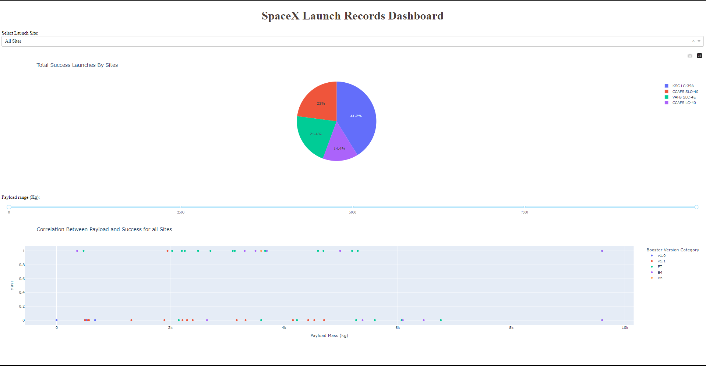
Results

Slide 19
Results
EDA Results
Launch Success Rate by Site:
CCAFS SLC-40: 41.2%
VAFB SLC-4E: 14.4%
KSC LC-39A: 23%
CCAFS LC-40: 21.4%
Payload Mass & Success:
Positive correlation observed
4000-6000 kg range shows higher success
Orbit Type & Success:
Highest: SSO, VLEO
Lowest: GTO
Yearly Trend:
Success rate improved post-2015
Peak around 2018-2019
Scatter Plot Insights:
Higher flight numbers → higher success
Specific payload masses suit certain orbits better
Predictive Analysis Results
Best Model: KNN
Accuracy: 83%
Precision: 0.80
Recall: 1.00
F1 Score: 0.89
ROC AUC: 0.90
Confusion Matrix (KNN):
TP: 12, FP: 3, TN: 3, FN: 0
ROC Curve:
KNN AUC: 0.90
Logistic Regression AUC: 0.89
SVM AUC: 0.89
Decision Tree AUC: 0.75
Cross-Validation:
KNN showed consistent performance across folds

Slide 20

Section 2

Slide 21
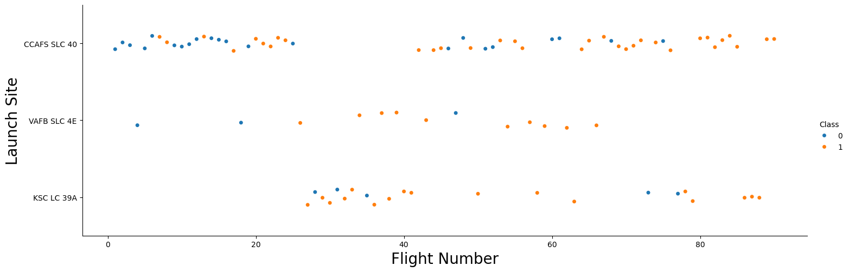
Flight Number vs. Launch Site
Scatter Plot Description:
Axes: The x-axis represents the Flight Number, while the y-axis represents the Launch Site.
Points: Each point represents a flight, with the color indicating the class of the launch outcome (0 for failure, 1 for success).
Insights:
Launch Sites: The plot includes three launch sites: CCAFS SLC 40, VAFB SLC 4E, and KSC LC 39A.
Flight Distribution: CCAFS SLC 40 has the most flights, followed by KSC LC 39A, and VAFB SLC 4E has the least.
Success Rate: The distribution of successful (orange) and failed (blue) launches shows that all three launch sites have a mix of successes and failures. However, there is a higher concentration of successful launches at CCAFS SLC 40 and KSC LC 39A compared to VAFB SLC 4E.
Trends Over Time: As the flight number increases, there is a noticeable trend of increased successful launches, particularly at CCAFS SLC 40 and KSC LC 39A, suggesting improvements in launch success over time.

Slide 22
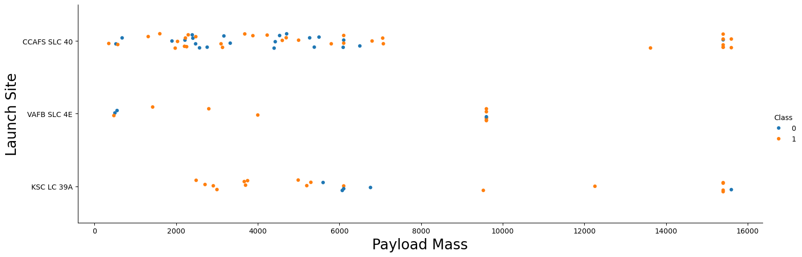
Payload vs. Launch Site
Scatter Plot Description:
Axes: The x-axis represents the Payload Mass (in kilograms), while the y-axis represents the Launch Site.
Points: Each point represents a launch, with the color indicating the class of the launch outcome (0 for failure, 1 for success.
Insights:
Launch Sites: The plot includes three launch sites: CCAFS SLC 40, VAFB SLC 4E, and KSC LC 39A.
Payload Distribution: CCAFS SLC 40 handles the widest range of payload masses, including some of the heaviest payloads.
Success Rate: The distribution of successful (orange) and failed (blue) launches can be observed across different payload masses and launch sites.

Slide 23
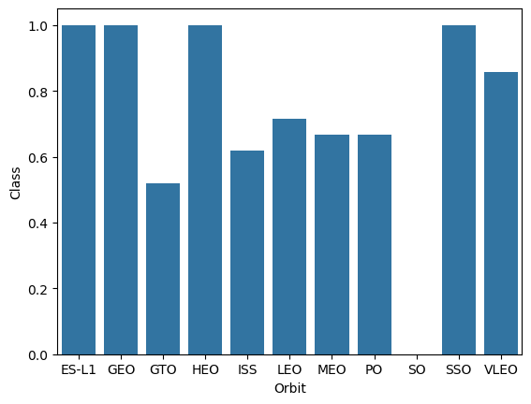
Scatter Plot Description:
Axes: The x-axis represents the Orbit Type, while the y-axis represents the Success Rate (Class 1 for success, 0 for failure).
Bars: Each bar represents the success rate for a specific orbit type.
Success Rate vs. Orbit Type
Insights:
High Success Rates: Orbit types such as ES-L1, GEO, HEO, SSO, and VLEO exhibit very high success rates, close to or at 100%.
Moderate Success Rates: LEO, MEO, and PO have moderate success rates, around 60-70%.
Low Success Rate: GTO (Geostationary Transfer Orbit) has the lowest success rate among the orbit types.

Slide 24
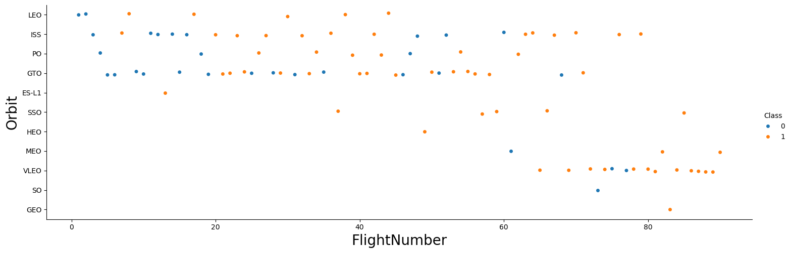
Flight Number vs. Orbit Type
Scatter Plot Description:
Axes: The x-axis represents the Flight Number, while the y-axis represents the Orbit Type.
Points: Each point represents a launch, with the color indicating the class of the launch outcome (0 for failure, 1 for success.
Insights:
Orbit Types: The plot includes various orbit types such as LEO, ISS, PO, GTO, ES-L1, SSO, HEO, MEO, VLEO, SO, and GEO.
Flight Distribution: The flight numbers are spread across different orbit types. LEO and GTO have the highest number of flights, indicating these orbits are more commonly targeted for missions.
Success Rate: There is a notable concentration of successful launches (orange points) for certain orbit types like LEO and SSO, while GTO shows a mix of successes and failures.
Trends Over Time: Higher flight numbers (later launches) tend to show an increased success rate, particularly for LEO and ISS orbits, suggesting improvements in technology and experience over time

Slide 25
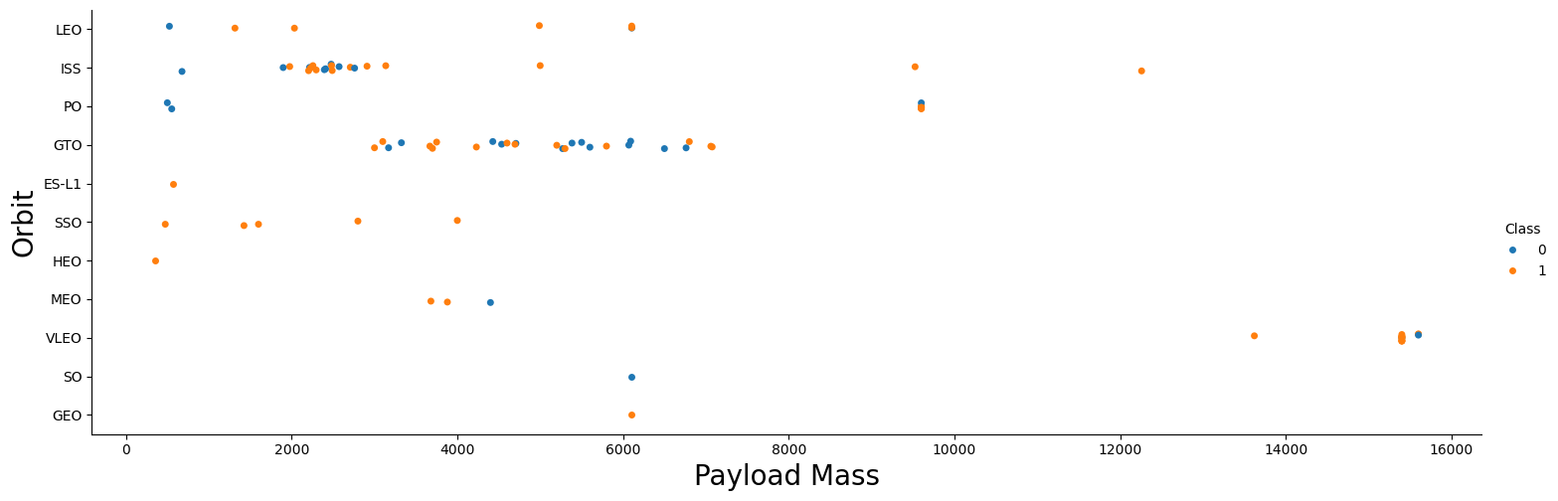
Payload vs. Orbit Type
Scatter Plot Description:
Axes: The x-axis represents the Payload Mass (in kilograms), while the y-axis represents the Orbit Type.
Points: Each point represents a launch, with the color indicating the class of the launch outcome (0 for failure, 1 for success.
Insights:
Orbit Types: The plot includes various orbit types such as LEO, ISS, PO, GTO, ES-L1, SSO, HEO, MEO, VLEO, SO, and GEO.
Payload Distribution: Different orbit types handle different ranges of payload masses. For example, LEO and ISS handle lighter payloads, typically below 10,000 kg while GTO and GEO Handle a wide range of payloads, including some of the heaviest payloads
Success Rate: The distribution of successful (orange) and failed (blue) launches across different payload masses and orbit types indicates:
High Success Rates: Orbits like SSO and LEO show a higher concentration of successful launches.
Mixed Success Rates: GTO shows a mix of successes and failures, especially for heavier payloads.
Trends Over Time: Heavier payloads are more frequently associated with higher orbits like GTO and GEO, while lower orbits like LEO handle a more uniform distribution of lighter payloads.

Slide 26
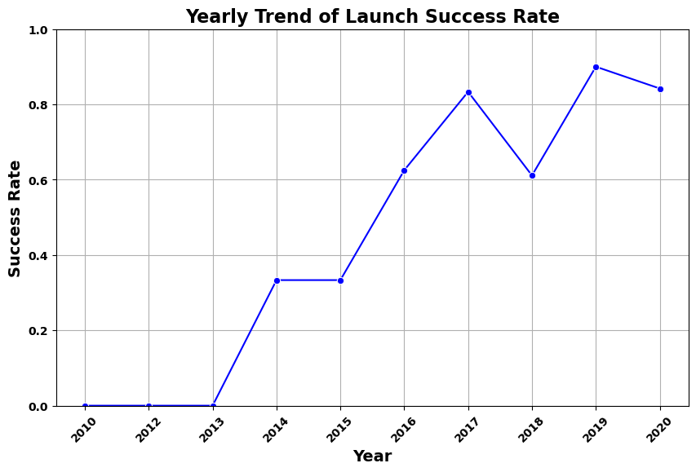
Scatter Plot Description:
Axes: The x-axis represents the Year, while the y-axis represents the Success Rate (Class 1 for success, 0 for failure).
Line: The line connects the average success rates for each year, with markers highlighting individual years.
Launch Success Yearly Trend
Insights:
Success Rate Trend: There is a clear upward trend in the success rate of launches from 2013 to 2020. This indicates a significant improvement in launch success over the years
Yearly Variation: Some years, like 2018, show a slight drop in success rate compared to previous years, but the overall trend remains positive
Recent Years: The most recent years (2019 and 2020) have very high success rates, close to or above 80%, reflecting advancements in technology and operational efficiency.

Slide 27
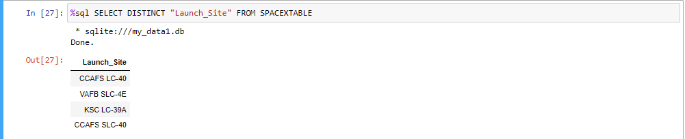
All Launch Site Names
Description
This query retrieves all unique launch sites from the SPACEXTABLE. Identifying unique launch sites is crucial for understanding the geographical distribution of SpaceX's operations. The results show that SpaceX primarily uses a few key locations for their launches, indicating their strategic importance. CCAFS LC-40 and CCAFS SLC-40 are frequently used, highlighting their significance in SpaceX's launch history.
Result:
CCAFS LC-40
VAFB SLC-4E
KSC LC-39A
CCAFS SLC-40

Slide 28
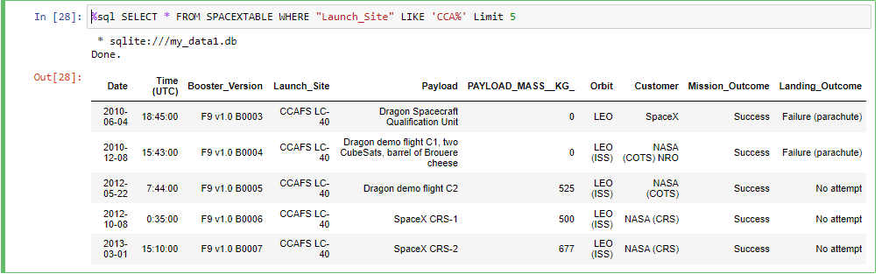
Launch Site Names Begin with 'CCA'
Description
This query retrieves detailed information for the first five launches where the launch site name starts with 'CCA'. It provides specific details such as date, time, payload, orbit, and mission outcome for these launches.
Result:
Five launch records with launch site names starting with 'CCA'

Slide 29
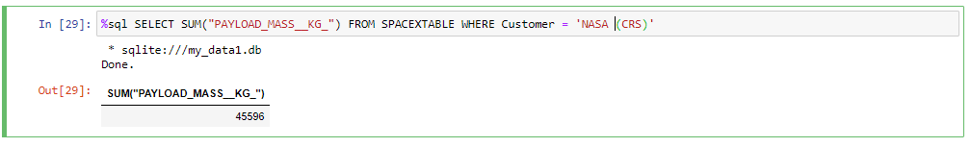
Total Payload Mass
Description
This query calculates the total payload mass for all NASA CRS missions. The result indicates that SpaceX has delivered a total payload mass of 45,596 kg for NASA's CRS missions. This demonstrates SpaceX's critical role in supporting NASA's cargo resupply missions to the ISS, highlighting their capability to transport substantial payloads efficiently and reliably.
Result:
SUM(PAYLOAD_MASS__KG_): 45,596 kg

Slide 30
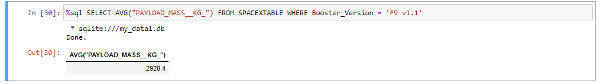
Average Payload Mass by F9 v1.1
Description
This query calculates the average payload mass for all launches using the F9 v1.1 booster version. With an average payload mass of 2,928.4 kg, this data provides insight into the performance and capacity of the F9 v1.1 booster. Understanding the payload capabilities of different booster versions helps in planning and optimizing future missions based on the type of payload and the required orbit.
Result:
AVG(PAYLOAD_MASS__KG_): 2,928.4 kg

Slide 31
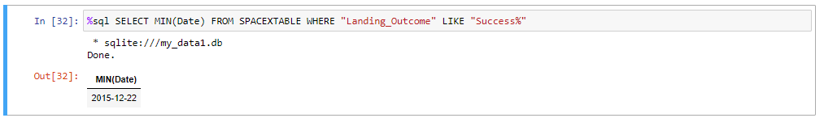
First Successful Ground Landing Date
Description
This query retrieves the earliest date on which a successful landing occurred. The result, December 22, 2015, marks a significant milestone in SpaceX's history, representing the first successful recovery of a rocket booster.
Result:
22nd, December 2015

Slide 32
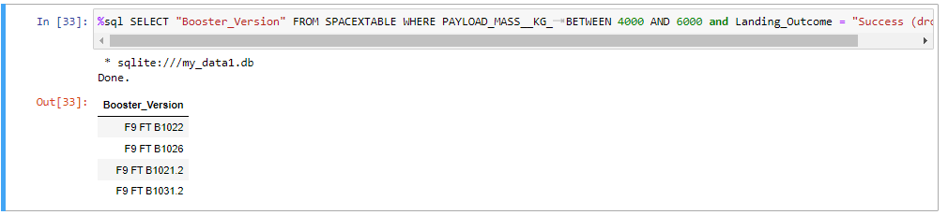
Successful Drone Ship Landing with Payload between 4000 and 6000
Description
This query lists the booster versions that successfully landed on a drone ship with payloads between 4000 and 6000 kg. It helps identify the boosters that have demonstrated successful performance under these specific payload conditions, useful for planning future launches.
Result:
Booster_Version: F9 FT B1022
Booster_Version: F9 FT B1026
Booster_Version: F9 FT B1021.2
Booster_Version: F9 FT B1031.2

Slide 33
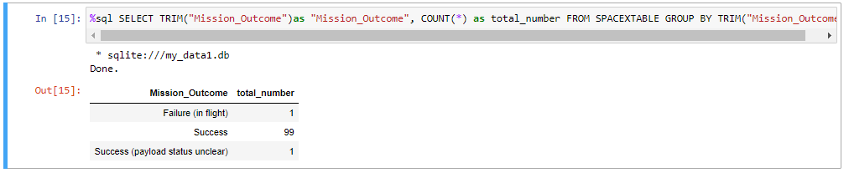
Total Number of Successful and Failure Mission Outcomes
Description
This query counts the total number of each type of mission outcome. The result shows that SpaceX has had a high success rate, with 99 successful missions, one in-flight failure, and one mission where the payload status was unclear. This summary helps in evaluating the overall mission performance and reliability of SpaceX launches.
Result:
Failure (in flight): 1
Success: 99
Success (payload status unclear): 1

Slide 34
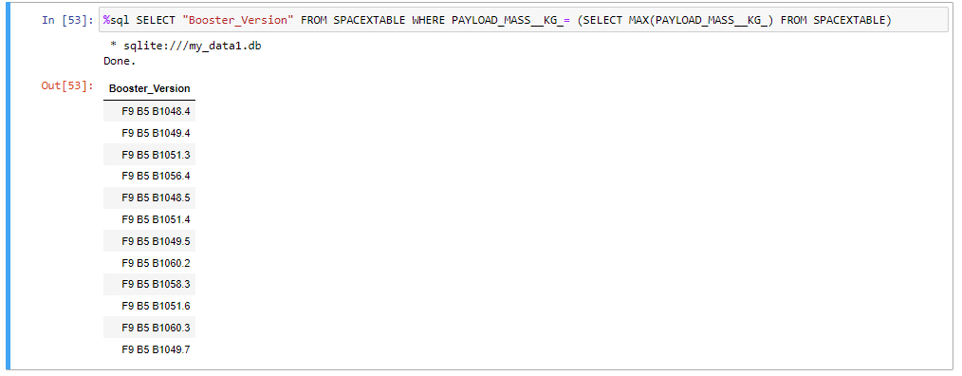
Boosters Carried Maximum Payload
Description
This query identifies the booster versions that carried the maximum payload mass of 15,600 kg. The result shows that multiple booster versions from the F9 B5 series have achieved this capacity. This demonstrates the high payload capability and reliability of these specific booster versions for heavy-lift missions.

Slide 35
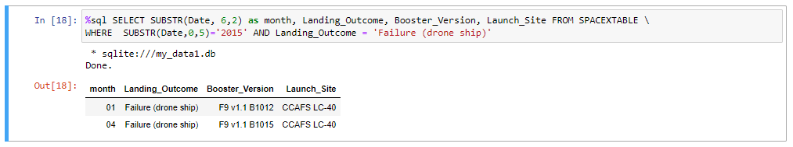
2015 Launch Records
Description
This query identifies the months in 2015 when launches failed on the drone ship, along with the corresponding booster versions and launch sites. It helps analyze the specific instances of failures to understand patterns or issues that occurred with particular boosters or conditions.
Result:
Month: January(01), Landing_Outcome: Failure (drone ship), Booster_Version: F9 v1.1 B1012, Launch_Site: CCAFS LC-40
Month: April (04), Landing_Outcome: Failure (drone ship), Booster_Version: F9 v1.1 B1015, Launch_Site: CCAFS LC-40

Slide 36
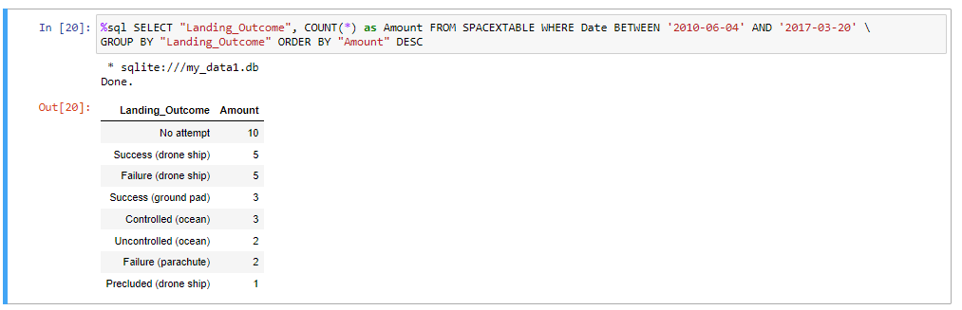
Rank Landing Outcomes Between 2010-06-04 and 2017-03-20
Description
This query ranks the different landing outcomes by their frequency between 2010 and 2017. It provides insights into the most common and least common landing outcomes, highlighting areas where SpaceX has been successful and areas that need improvement.
Result:
No attempt:10
Success (drone ship): 5
Failure (drone ship): 5
Success (ground pad): 3
Controlled (ocean): 3
Uncontrolled (ocean): 2
Failure (parachute): 2
Precluded (drone ship): 1

Slide 37

Section 3

Slide 38
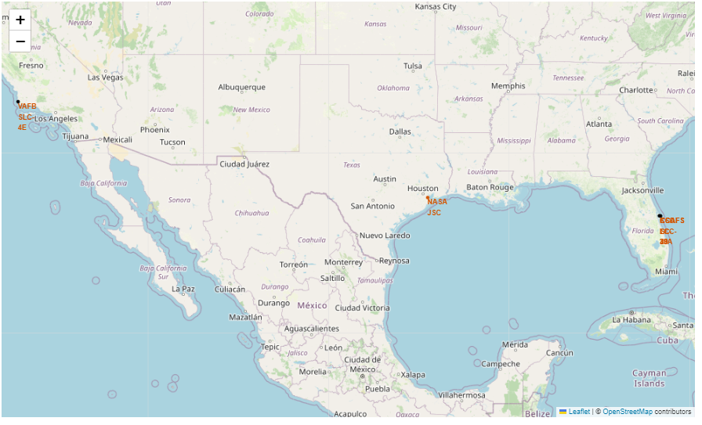
Global Map of SpaceX Launch Sites
Markers: Each marker represents a SpaceX launch site.
Locations: The map shows launch sites at CCAFS SLC-40, VAFB SLC-4E, and KSC LC-39A.
Key Findings:
Concentration of Sites: Most of SpaceX’s launch sites are located along the coasts, providing ideal locations for eastward launches over the ocean, which is crucial for safety and orbital mechanics.
Geographical Spread: The spread across different states ensures flexibility and coverage for various mission requirements.

Slide 39
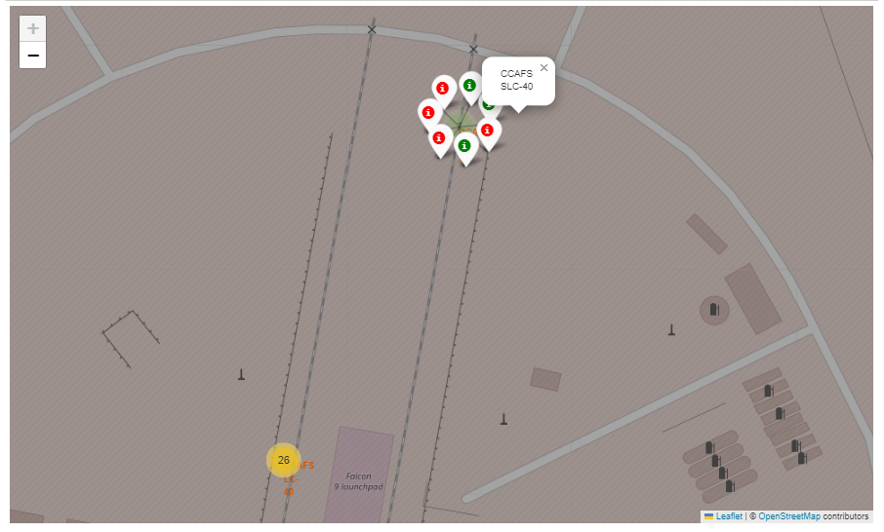
Launch Outcomes at CCAFS SLC-40
Color-Coded Markers: Red markers indicate failed launches, and green markers indicate successful launches.
Location Focus: This map zooms in on the CCAFS SLC-40 launch site to show specific outcomes.
Key Findings:
Cluster of Outcomes: The clustering of outcomes at CCAFS SLC-40 reveals the high activity level at this site.
Success Rate: A visual inspection shows a mix of successful and failed launches, providing insights into the site's performance and areas for potential improvement.

Slide 40
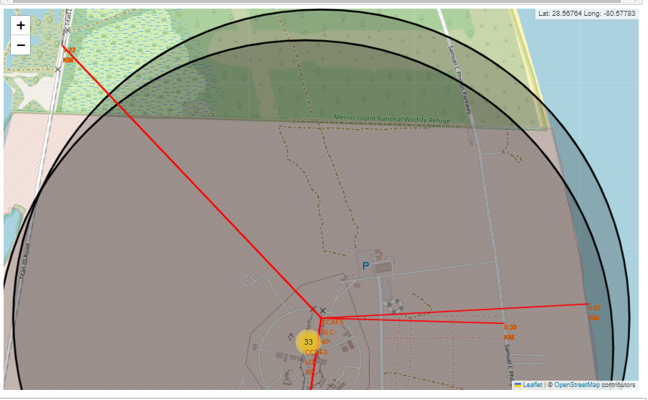
Proximity Analysis of CCAFS SLC-40
Elements
Distance Circles: Circles show the distance from the launch site to nearby infrastructure.
Proximities: This map includes proximities to the nearest railway, highway, and coastline.
Key Findings:
Railway and Highway Proximity: The close proximity to railways and highways facilitates easy transportation of rocket components and personnel.
Coastline Distance: The nearby coastline is advantageous for eastward launches, providing a safe trajectory over the ocean.
Logistics: The map underscores the strategic placement of the launch site to optimize logistics and safety.

Slide 41

Section 4

Slide 42
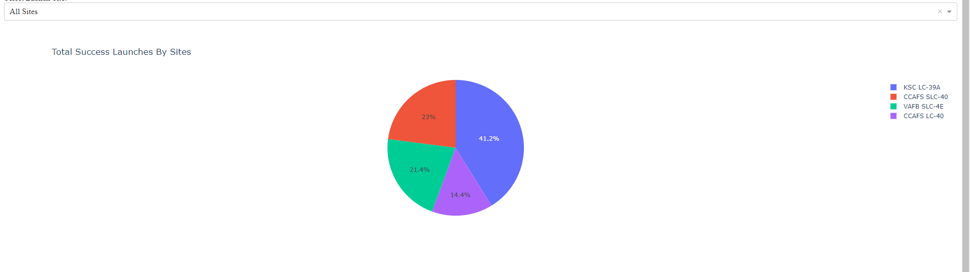
Total Success Launches by Site
Description
Pie Chart: Shows the proportion of successful launches from each site.
Legend: Indicates which color corresponds to which launch site.
Key findings
KSC LC-39A: Accounts for 41.2% of successful launches.
CCAFS SLC-40: Accounts for 23%
VAFB SLC-4E: Accounts for 21.4%.
CCAFS LC-40: Accounts for 14.4%.

Slide 43
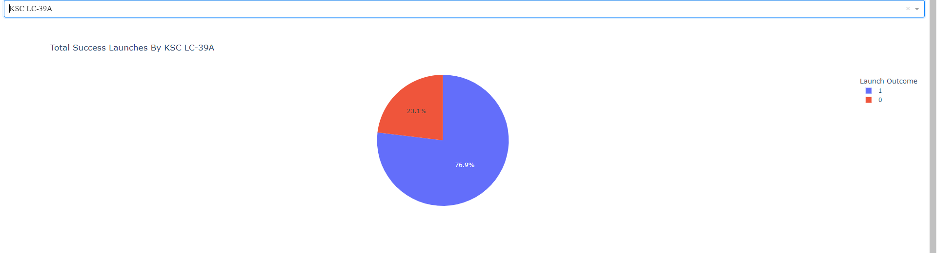
Launch Success Count for KSC LC-39A
Description
Pie Chart: Displays the success and failure rates for launches at KSC LC-39A.
Color Coding: Blue represents successful launches (76.9%), and red represents failures (23.1%)
Key findings
High Success Rate: KSC LC-39A has a high success rate of 76.9%, indicating its reliability and efficiency.
Failure Analysis: The 23.1% failure rate highlights areas for potential improvement.

Slide 44
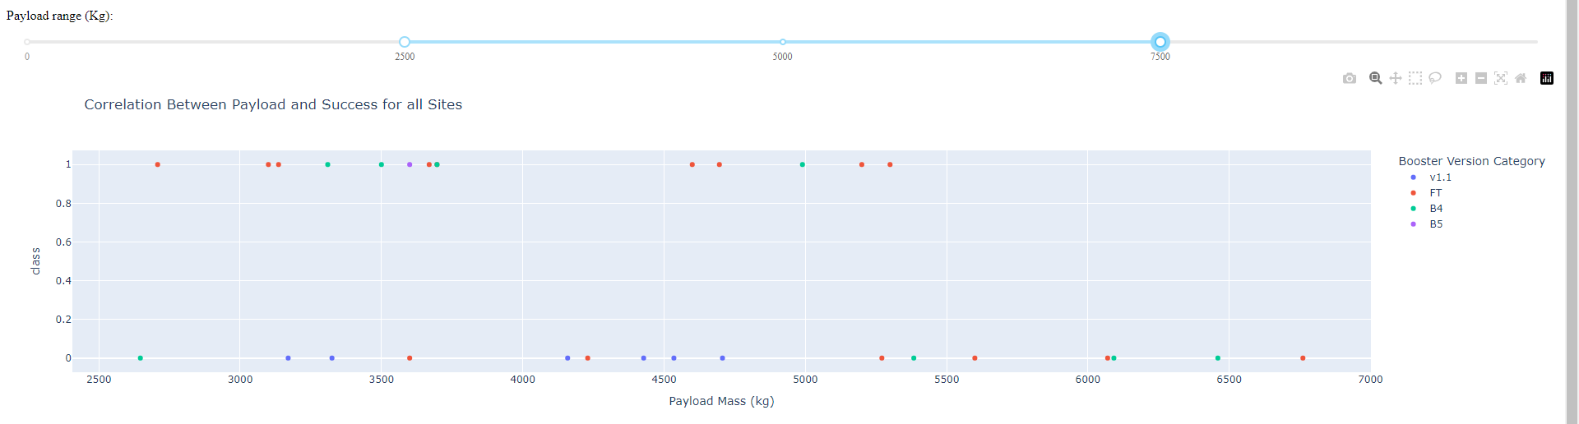
Correlation Between Payload and Launch Outcome
Description
Scatter Plot: Displays the relationship between payload mass and launch success across all sites.
Range Slider: Allows selection of different payload ranges.Booster
Version Colors: Different booster versions are color-coded for easy identification.
Key findings
Payload Range: Payloads between 3000 kg and 6000 kg show a higher concentration of successful launches (class = 1), indicating this range might be optimal for achieving successful launches.
Booster Versions: The B5 booster version (purple) shows a higher number of successful launches across various payload masses, suggesting that it is a more reliable booster.
Lower Payload Masses: For payloads below 2500 kg, the spread indicates variability in outcomes for lighter payloads.

Slide 45

Section 5

Slide 46
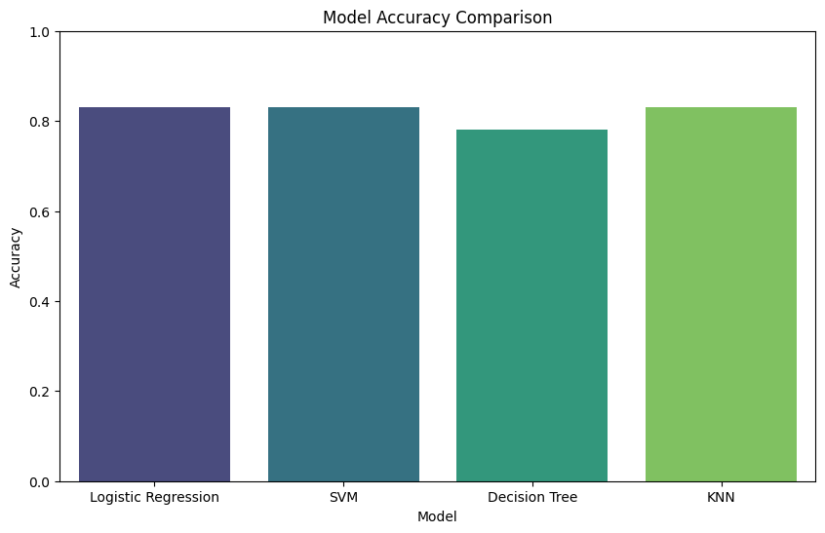
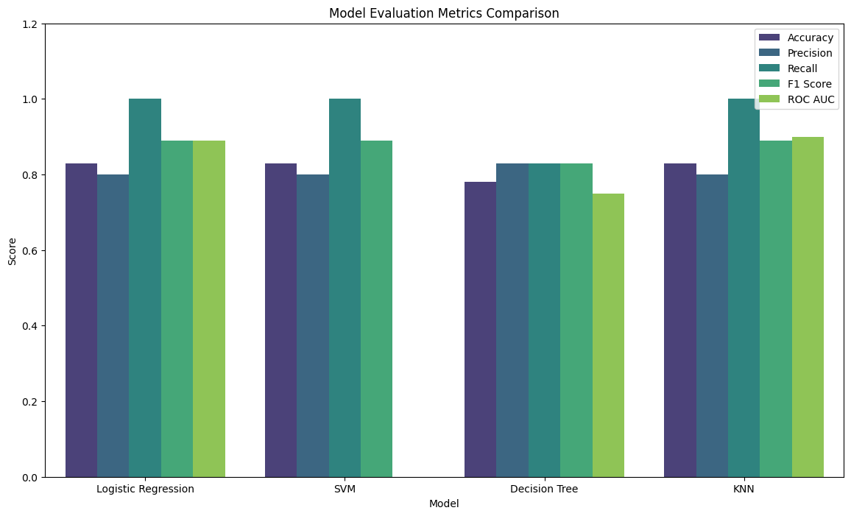
Classification Accuracy
Findings:
Highest Accuracy: Logistic Regression, SVM, and KNN models all achieved the highest accuracy of 0.83
Highest ROC AUC: The KNN model has the highest ROC AUC score of 0.90, indicating its superior performance in distinguishing between the classes.
Balanced Performance: Logistic Regression and KNN models show balanced performance across all evaluation metrics, making them reliable choices for this classification task.

Slide 47

Confusion Matrix
Confusion Matrix Analysis:
True Negatives (did not land): 3
These are instances where the actual class was "did not land," and the model correctly predicted "did not land."
False Positives (did not land): 3
These are instances where the actual class was "did not land," but the model incorrectly predicted "land."
False Negatives (landed): 0
These are instances where the actual class was "landed," but the model incorrectly predicted "did not land."
True Positives (landed): 12
These are instances where the actual class was "landed," and the model correctly predicted "land.“
Observations
High True Positive Rate: The model has a high true positive rate (recall) for the "landed" class, indicating its strong ability to correctly identify successful landings.
False Positives: There are a few false positives, where the model incorrectly predicted a landing. This suggests that while the model is highly accurate in predicting landings, there is some room for improvement in reducing false positive predictions.
The confusion matrix highlights the KNN model's overall effectiveness and areas for potential refinement, ensuring accurate predictions for SpaceX's landing outcomes.

Slide 48
Conclusions
Successful Data Collection and Wrangling
Efficiently gathered and cleaned data from SpaceX API and Wikipedia, creating a usable foundation for data analyss.
Comprehensive Exploratory Data Analysis
Utilized thorough EDA to reveal key launch success factors (launch site, payload mass) and yearly trends.
Robust Model Building and Evaluation
Implemented and evaluated different machine learning models (SVM, Logistic Regession, Decision Tree, KNN) to predict the likelihood of reusing the first stage of SpaceX rockets. These models (KNN), evaluated and refined to achieve high accuracy, reliably predict first stage reuse based on historical data, offering a strategic advantage.
Insightful Dashboards:
Developed interactive dashboards that provide clear, visual insights into SpaceX's launch outcomes, launch site performance, and payload correlations, empowering our team with valuable data at their fingertips.
First Stage Reusability Prediction:
Developed and evaluated machine learning models to predict the reusability of the first stage, identifying the KNN model as the best performer with high accuracy and ROC AUC scores.
Data-Driven Decision Making:
Created interactive dashboards using Folium and Plotly Dash to visualize key insights such as launch outcomes, success rates by site, payload correlations, and yearly trends, providing valuable information for strategic planning.
Optimization of Launch Operations:
Conducted exploratory data analysis to identify critical factors influencing launch success, such as launch site, payload mass, and orbit type, offering actionable insights for optimizing Space Y's launch operations
Future Research Directions:
This project offers a thorough understanding of SpaceX's launch operations, enabling Space Y to benchmark its strategies and operations against a leading industry competition. However, future work will involve integrating cost data and developing models to accurately estimate launch costs based on SpaceX’s benchmarks.

Slide 49
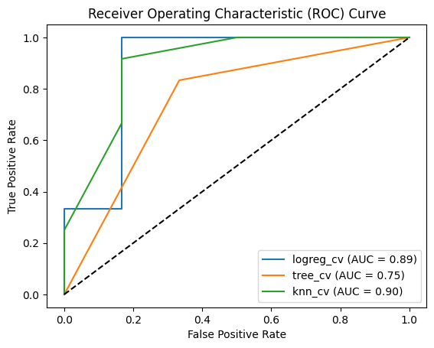
Appendix A: Model Performance Metrics

Slide 50


